Slide 1
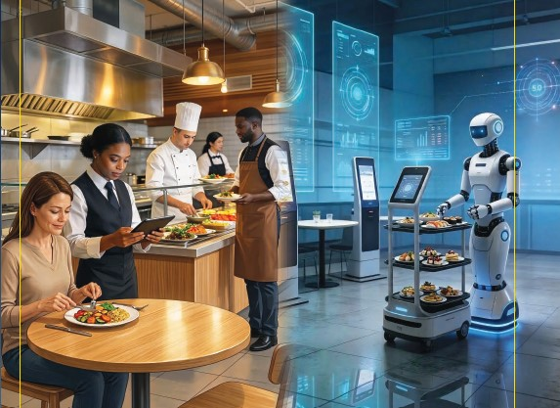

Chapter 1
Introduction to Culinary and Food Service Operations
Management for Industry 5.0

Slide 2
Chapter 1
Sets the scene and the core philosophy behind the book.
The chapter covers:
The principles that lie behind culinary and food service operations management 5.0.
Industry 5.0 strategies within the context of the book, human centric, resilience and sustainability
The diversity of the culinary and food service operations and a framework by which they can be identified
The concept of the experience economy and experiential dining and their influence on developing the offer

Slide 3
Industrial Revolution 1.0 to 5.0
Revolution | Themes | Year | Examples of Food Service Operations
Industry 1.0 | Mechanisation, water and steam power | 1800 | Coal fired ovens; mechanical ice cream makers churned by hand
Industry 2.0 | Mass production, electric power and assembly lines | 1900 | Development of the Partie system in the kitchen and restaurant to create areas of specialism and speed production and service
Industry 3.0 | Computers automated production, electronics | 2000 | Use of Electronic Point of Sale (EPOS) automated ordering from suppliers and creation of big data.
Industry 4.0 | Cyber-physical systems, Internet of Things, networking, machine learning | 2010 | Use of cloud data storage, networking of kitchen and food service functions and third-party food ordering systems and guest interactions through phone table ordering
Industry 5.0 | Human-robot collaboration, cognitive systems, customization | 2020 | The use of robotics in food production and the use of `Bella` robots in food service to assist with repetitive tasks and attract customers with their novelty usage

Slide 4
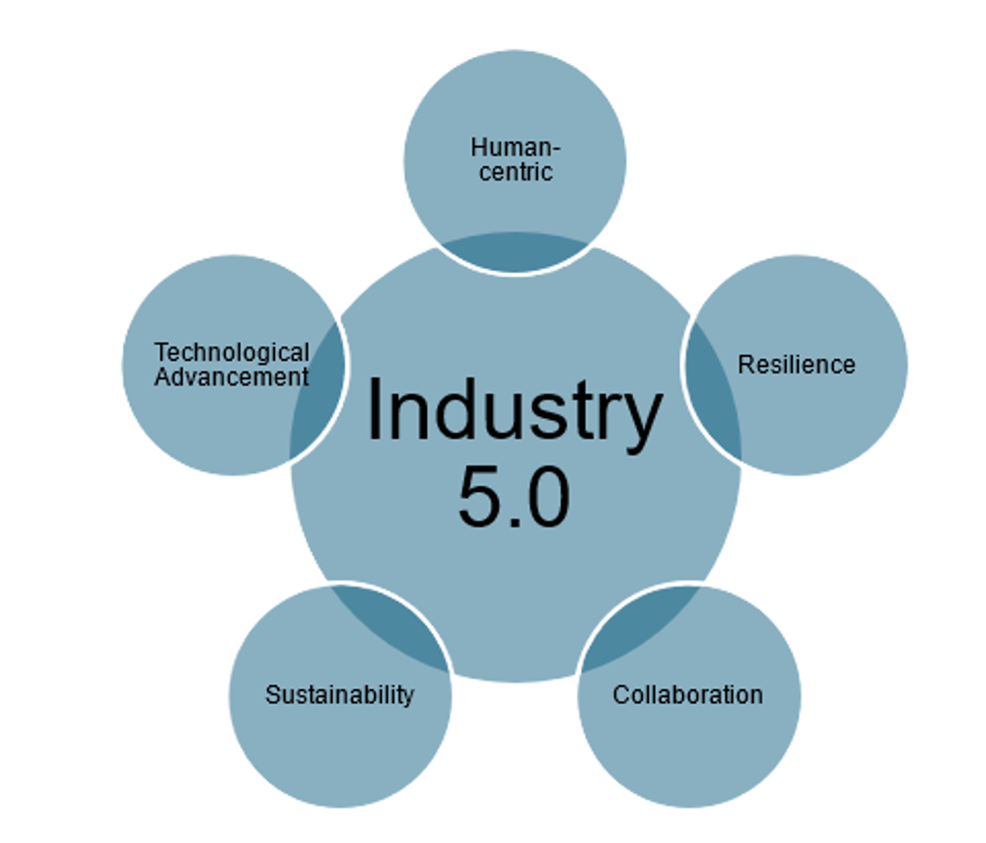
Five Pillars of Industry 5.0

Slide 5
1. Humancentric
For the service industry and the food service operator this is nothing new.
Concept identifies that placing human beings at the centre of the production process
Moves away for the operations management perspective of efficiency and productivity
Mass customisation delivered in a manner which offers the customer highly personalised guest experiences
Human beings are allowed to work within a framework which offers variety within the parameters of the offer
Brand values and operational delivery issues of staff are covered in concepts of emotional and aesthetic labour

Slide 6
2. Resilience
Culinary and food service operations management is constantly having to evolve
Fashions, taste and cultural requirements change.
Without adaptation the result is business failure and closer
A demand led business. Those that can innovate are leaders, in setting the agenda for others to imitate
Resilience is part of the culinary and food service business `DNA`
The mantra of Industry 5.0 is creating resilient industrial systems that can adapt to changing conditions and challenges

Slide 7
3. Sustainability
Production and service of food production and service should reflect peace and prosperity while tackling climate change
These are enshrined within 17 Sustainability Goals (SDGs) as set out by the United Nations
Triple bottom line – People/Plant/Profit

Slide 8
4. Collaboration
Food service operators promote the collaboration between machines and humans.
The machine handles repetitive and dangerous activity
Food service operators have applied machine delivery in fast food and quick service restaurants
Robotics and technology has been embraced and applied within the culinary and food service business to enhance customer experience and improve decision making

Slide 9
5. Technological advancement
Culinary and food service management builds on the advancement of previous industrial advancements and incorporates the technologies with a focus on the human-centric applications
Artificial intelligence (AI) is a transformative technology for the service industry
It has fundamentally reshaped the operational delivery, through machine learning, robotics and natural language processing. Examples of this are robots, AI, and virtual reality

Slide 10
The operator challenges
Human capital
Competitiveness
Innovation

Slide 11
The meaning behind industry 5.0
For the culinary and food service industry arguably the impact of Industry 5.0 has only just begun
Globalisation has been a period of fundamental change
The era of uncertainty through national disruptors and geopolitics is having a profound effect
The delivery of culinary and food service will always be present

Slide 12
Diversity of culinary and food service offers
Commercial
Restaurants (fine dining, independent, chain, branded)
Hotels (star rating, country, health, guesthouse, seaside, towns, boutique)
Transport (air, land, sea)
Fast Food (high street, dark kitchens)
Quick Service (branded, independent)
Take away (high street, sit down)
Camps (holiday, caravan, camping)
Service – inhouse and contract
Education (university, colleges, schools, nursery)
Hospitals (private, state, staff patients, meals on wheels, residential, nursing homes)
Prisons (adult, young offenders, privatised)
Forces (army, navy, air force, police).
Industry workplaces

Slide 13
Methods for defining culinary and food service offers
Price / service categorisation
Sector analysis
Meal experience
Price v Service
Food v entertainment "eatertainment“
Product attributes

Slide 14
Summary
Culinary and food service operations has been fundamentally impacted through industry eras with 5.0 on the horizon
There is a new lens which we need to review the approach to doing culinary and food service business
Traditionality continues to be relevant, but this is being constantly challenged
New ways of working are impacting the approach to culinary and food service operations

Slide 15
Revision Questions
What is Industry 5.0?
What are the elements that define the concept of Industry 5.0?
How can culinary and food service operators be defined and categorised?

Slide 16
End of Chapter 1 presentation

Slide 17
Culinary and Food Service Operations Management for Industry 5.0
David Graham is an Associate Head at Sheffield Hallam University within Sheffield Business School, a visiting Research Fellow at the University of Zululand, South Africa and Principal Fellow of Higher Education Academy.
Ewen Crilley is a Senior Lecturer at Sheffield Hallam University and Course Leader for UG and PG Tourism, Hospitality, Culinary and Aviation.
Peter Cox worked in the hotel and contract catering for large international companies. He was a Senior Lecturer at Leeds Beckett University specialising in quality and hospitality operations management.
John Cousins is a consultant, educator, and the author of a range of food and beverage management and service publications, He has been conferred at Culinary Arts Laureate and is Director of the Food and Beverage Training Company.
© 2026 David Graham et al. Culinary and Food Service Operations Management for Industry 5.0. Goodfellow Publishers

